Slide 1
CTEC Project Presentation
Zhang Haorui P02 (2101806D)

Slide 2
About Web Application
Web Name: MindReaders
A book review website allows users to comment on the books they would like to review.
Functionalities
Register account
Edit account details
Delete account
Login/Logout
Retrieve all comment
Add comment
Edit comment
Delete comment

Slide 3
AWS Services Used
Elastic Computing Cloud (EC2)
Relational Database Service (RDS)
Simple Storage Service (S3)
Virtual Private Cloud (VPC)
CloudWatch
Simple Notification Service (SNS)

Slide 4
Elastic Computing Cloud (EC2)
Secure
Requiring a set of key pairs to prove the identity of the user when connecting to an EC2 instance (EC2 provides the service of creating a key pair).
Strong firewall where security group is automatically created and enabled to control the Internet traffic.
A port number must be specified in the EC2 instance to ensure that the port number can be connected to a device.
VPC is also enabled to ensure that only users from a specific region or IP address can access the web application .

Slide 5
Elastic Computing Cloud (EC2)
Easy to use
With the help of GitHub, the web application codes can be cloned immediately to the Linux Virtual Desktop.
To connect the EC2 instance from the laptop, Amazon provides SSH codes to access the instance directly.
Once connected to Linux Virtual Desktop, install node modules in the cloned GitHub folder, and host the web application on the public Internet .

Slide 6
Relational Database Service (RDS)
Versatile
No need to use AWS DynamoDB as the web database.
RDS accepts different SQL databases such as MySQL, Amazon Aurora, MariaDB, Microsoft SQL Server, etc.
Storage autoscaling increases the storage of the database after reaching a certain threshold.
Secure
Requires username and password for DB instances.
Disables any changes to Virtual Private Cloud after setting up RDS.
VPC groups are limited to a certain group of users connecting to the database, preventing hackers from accessing the database easily.

Slide 7
Simple Storage Service (S3)
Storage
Able to store images in the S3 service and show the image on the web application using the S3 URL provided by AWS.
Ease of Management
Able to grant permissions (Read, Write) to the different groups of users through the Access Control List.

Slide 8
Virtual Private Cloud (VPC)
Security
Security groups in VPC control inbound and outbound traffic connections, acting as a firewall.
By default, security groups disable inbound connections to EC2 instances from any port unless a port number is defined and is permitted to be connected based on the IP address.
This ensures that no one can intrude on the Linux Virtual Computer remotely.

Slide 9
CloudWatch
Monitoring and management service
Easy Analysis
CloudWatch logs CPU Utilisation, the rate at which data is transmitted in and out of the different AWS services (EC2 & RDS).
Reminders
CloudWatch also enables alarms, which will notify users once an AWS service reaches a specific limit.
It can also allow certain actions to be implemented, such as shutting down an AWS service after reaching a certain limit.

Slide 10
Simple Notification Service (SNS)
An AWS service that allows notifications/reminders to be made to end users or developers.
In this case, email is the notification sent to the developer.
Interactive with other AWS services
Coupled by CloudWatch, these two services can work together.
Provide reminders to developers who might have neglected some AWS services.

Slide 11
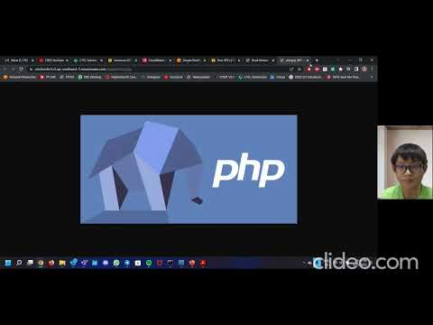
Demonstration

